Slide 1
Urban Regeneration
A Case for Indonesia

Slide 2
Urban Regeneration - Why?

Slide 3


Urbanization in Indonesia
Indonesia is experiencing rapid urbanization but cities not realizing full potential.
$$$
Rapid Urbanization.
Over 55% of Indonesia’s national population (approximately 149 million) living in towns and cities in 2017.
Cities have not realized full potential.
While contributing to 57% of GDP in 2010-2016, Indonesian cities have not fully benefited from the potential of urbanization.
Urbanization not Matched by Adequate Urban Infrastructure Investment and Development
Significant deficits across urban infra sectors causing challenges of traffic congestion, poor water and sanitation, and energy shortages.
Underinvestment has led to an estimated US$ 1.5 trillion infra deficit in Indonesia.

Slide 4
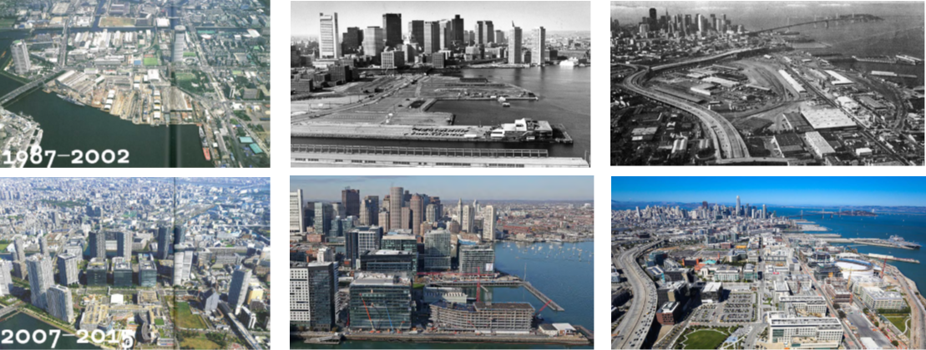
Urban Regeneration of Underutilized Urban Land
By regenerating and recycling pockets of underused land and promote dense and well-connected neighborhoods, cities may tackle the issue of sprawl and facilitate growth. Urban regeneration in an attempt to reserve a decline in a city/district by improving the physical structure and economy of those areas. In all urban regeneration projects, public money is used to catalyze private investment into these areas.
Tokyo, Japan
Boston Seaport, USA
Mission Bay SF, USA
c. 1980s
1980
2018
2018
Source: World Bank, Tokyo Learning Development Center, Technical Deep Dive on Urban Regeneration, February 18-23, 2019

Slide 5
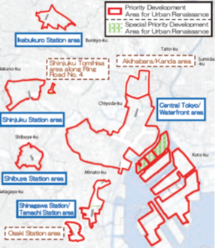
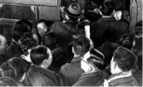
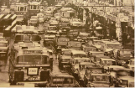
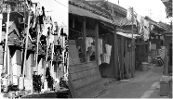
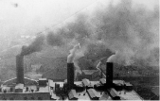
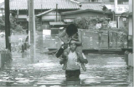
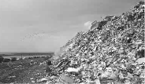
Tokyo: Special Urban Regeneration (Renaissance) Districts
Challenge
Response
Urban expansion along rail lines and re-densification of CBD
Act on Special Measures for Urban Regeneration (2002)
Designation of Special Urban Regeneration (Renaissance) Districts (selected through a national survey of candidate districts)
Comprehensive Development Projects for Residential Urban Areas (2004), three types:
For growth pole development
For dense urban residential area improvement
For downtown redevelopment
Negative urbanization impacts (“commuting hell,” traffic, inadequate housing, pollution, flooding, SWM issues) and aging population
Special Priority Development Areas and Priority Development Areas for Urban Renaissance
Source: World Bank, Tokyo Learning Development Center, Technical Deep Dive on Urban Regeneration, February 18-23, 2019

Slide 6
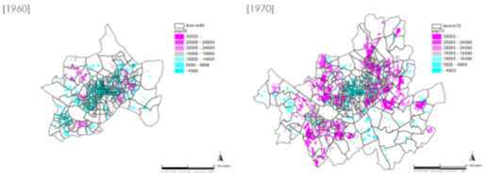
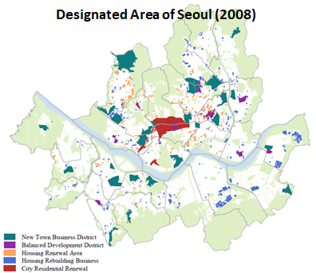
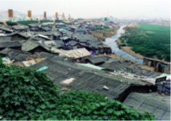
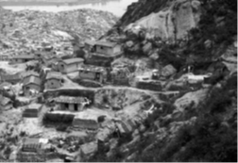
Seoul: Promotion of Urban Renewal/Regeneration
Challenge
Response
City unprepared for rapid urbanization
Promotion of Urban Renewal/Regeneration
New Town policy of Seoul in the early 2000s promote large-scale redevelopment by bundling previous development units
Establishment of Special Law (2013) to contribute to the Quality Of Life (QOL) of the people, such as the expansion of the base for sustainable growth of cities, improvement of competitiveness of cities, and recover of local community,
Formation of slum settlements along riverbanks and mountain sides leads to government led slum clearance and migration (met with resistance).
Source: World Bank, Tokyo Learning Development Center, Technical Deep Dive on Urban Regeneration, February 18-23, 2019

Slide 7
Johannesburg: Strategic Spatial Interventions for UR
Challenge
Response
Decentralized Urban System
Strategic spatial interventions as an approach to urban regeneration through levers of government:
Land use planning and management
Public infrastructure investment
Public property development and release
Financial mechanisms
Urban management and ongoing operations
Select areas that will have maximum impact and draft precinct plans
Implement targeted public investments and programs using precinct plans
Building confidence in securing value of areas
Private sector willing to invest in both private properties and public spaces
Increase in general property market and in overall functioning of area
Approach to
Urban
Regeneration
Decentralized nodes – racial segregation
Disparity in levels of services and infrastructure
Prior to 1994 areas designated for Black South Africans: No property ownership and limited business rights
Unemployment Rate
Source: World Bank, Tokyo Learning Development Center, Technical Deep Dive on Urban Regeneration, February 18-23, 2019

Slide 8
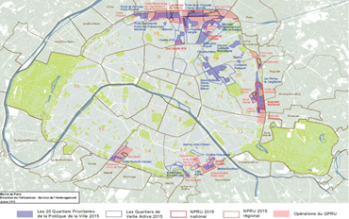
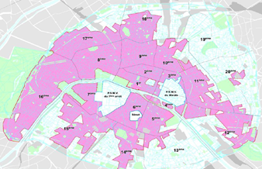
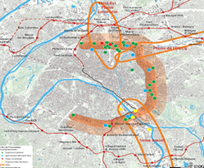
Paris: Operations of Urban Renewal
Challenge
Response
Reduce equalities for a more united Paris and build on innovation potential.
Operations of Urban Renewal (approx. 70 Development Projects)
Deficit Zone in Social Housing
Sites:
Old railway wasteland, Former hospitals and warehouses, Public spaces in peripheral area, embankments of the ring road (Great Urban Renewal Project)
Purposes
Increase housing units, business premises and offices
Develop a more pleasant residential environment with public facilities
Enhance the green belt and the green network
Create links by crossing urban rupture
Connect new neighborhoods with public transport, multi-modal hubs
Change the great landscape with new monuments
Method
Social and functional mix
Public facilities according to inhabitants needs
Public consultation and meeting before choosing projects
Ambitious environmental targets
Architectural diversity
Costs balanced by recipes
Innovation Arc
Land and/or real estate potential
Spaces dedicated for emerging economy or new industries
Potential for new use and development
Social and societal innovation linked to new lifestyles
Source: World Bank, Tokyo Learning Development Center, Technical Deep Dive on Urban Regeneration, February 18-23, 2019

Slide 9
Urban Regeneration - How?

Slide 10
The Tools for Urban Regeneration
There are four distinct phases for the process of UR: scoping, planning, financing, and implementation.
IMPLEMENTATION
Requires leadership, risk management, viable market conditions, sustainable operating model
TOOLS FOR URBAN REGENERATION
SCOPING
Generate vision, conduct strategic assessment of opportunity, engage stakeholders
Strong Political Leadership
Project Chasing
1
Long-Term Institutional Arrangements
Scoping
Micro Level
Macro Level
Public & Private Sector Roles & Relationships
Managing Risk
Implementation
ASSETS
LAND, COMMUNITY & ENVIRONMENT
2
PLANNING
Create land use plan & infrastructure strategy that incorporates market dynamics, maximizes connectivity, anticipates private sector investments
FINANCING
Engage in capital investment planning, invest municipal resources, attract & leverage private capital
4
Planning
Framework Plan
Planning Process
Municipal Financial Tool
3
Planning Regulations
Planning Process
Financing
Planning Regulations
Implementation Plan
Source: World Bank, Regenerating Urban Land – A Practitioner’s Guide to Leveraging Private Investment

Slide 11
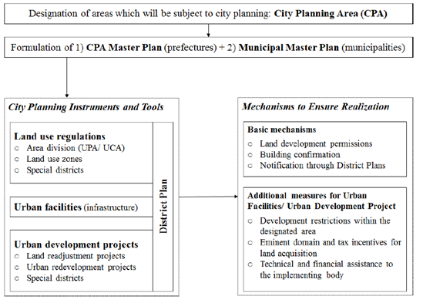
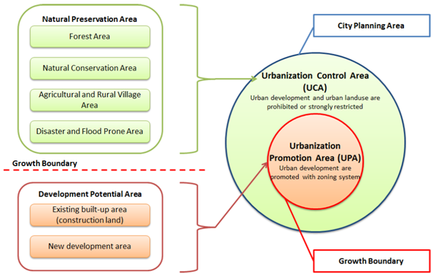
Planning - Enabling Policies/Regulations (Japan)
Japan’ City Planning System
Japan’s Key Urban Policies/Regulations
Source: World Bank, Tokyo Learning Development Center, Technical Deep Dive on Urban Regeneration, February 18-23, 2019

Slide 12
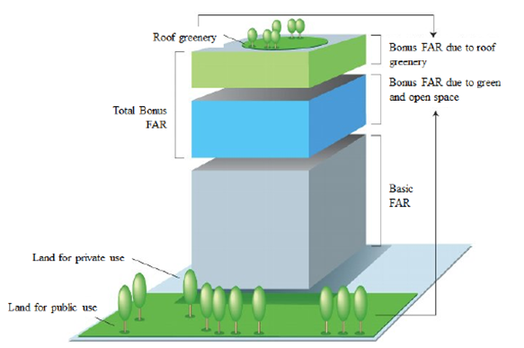
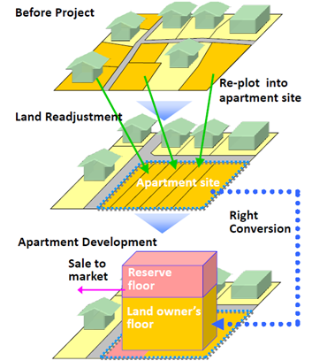
Planning - Enabling Policies/Regulations (Japan)
Bonus and Transfer of Floor Area Ratios (FARs)
Significantly higher FAR allowances are granted as a “bonus” in return for private investments in public facilities (i.e. station plaza, open space, pedestrian walkways)
Unused FAR can be transferred to another building in the area as an air rights transfer (only in certain District Planning areas)
Land Readjustment
Land parcels may be reorganized to enable the public and private sector to carry our necessary development projects to serve public interests through provision of infrastructure and service delivery
Alternative to land acquisition, and can be done through land rights conversion or whole purchase.
Source: World Bank, Tokyo Learning Development Center, Technical Deep Dive on Urban Regeneration, February 18-23, 2019

Slide 13
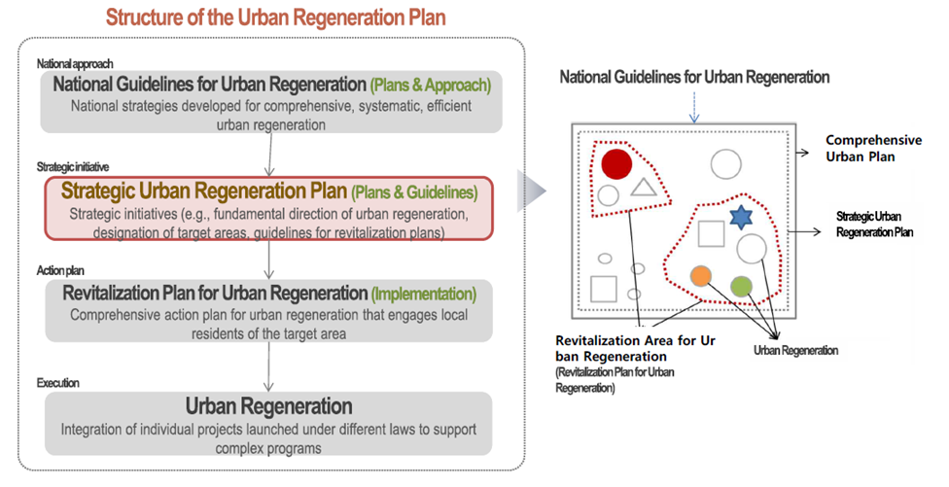
Planning - Enabling Policies/Regulations (Korea)
Korea’s Planning Structure and Guidelines for UR
Source: World Bank, Tokyo Learning Development Center, Technical Deep Dive on Urban Regeneration, February 18-23, 2019

Slide 14
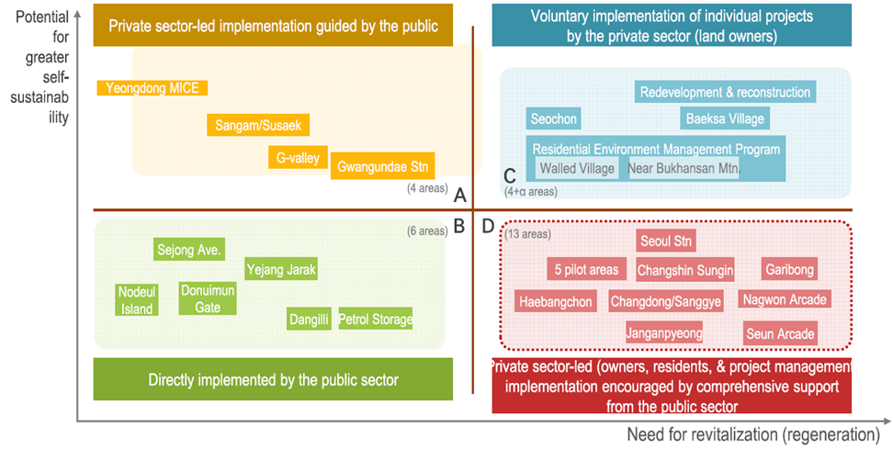
Planning - Enabling Policies/Regulations (Korea)
Level of implementation according to level of decline and potential for greater self-sustainability
Source: World Bank, Tokyo Learning Development Center, Technical Deep Dive on Urban Regeneration, February 18-23, 2019

Slide 15
Financing - Funding Sources for UR
In all UR projects, public money is uses to catalyze private investment into these areas.
Sources of Financing for UR
Theory of Land-Based Financing in UR (Land Value Capture)
Public Finance
Fiscal Transfers
Calculate
(Estimate)
Capture
Create
Own Source Revenues
Invest in infrastructure upgrade
Upgraded land commands higher values
Municipal Borrowing
Private Finance
Private Equity
Debt
Blended
Concessions
Underserviced Land
Private developer earns provides from further land improvements
Other Public-Private Collaboration
Balance-Sheet Funded Development Agencies
Part of value increase is captured by the City
Joint Venture
Source: World Bank, Tokyo Learning Development Center, Technical Deep Dive on Urban Regeneration, February 18-23, 2019

Slide 16
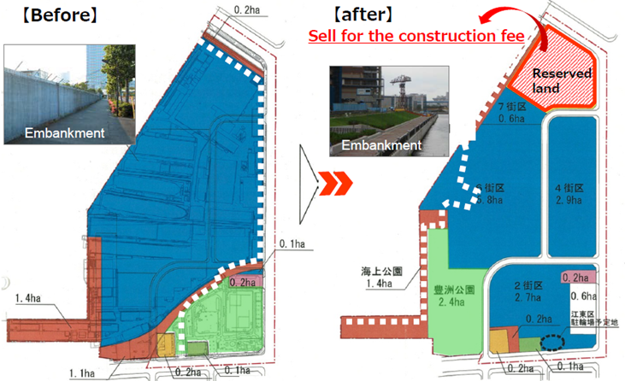
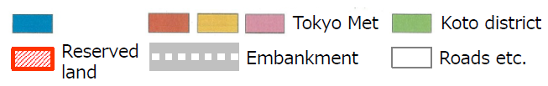
Financing - Example of Land Sales
Toyosu, Tokyo, Japan. In 2002, the existing shipyard in Toyosu was closed and infrastructure and office building development commenced, with the aim of adding value to the area by applying town management. The private sector conducted land relocation and reconstruction of the public facilities (roads, parks, water supply, sewage, seawalls/embankment, etc.). The private sector supplied land for roads and parks and earned construction fees through the sale of reserved lands and government subsidies.
Investment Plan for Infrastructure Development at Toyosu District 2
Revenues | Sales of reserved land
 | Government Subsidies
Expenditure | Construction cost of public facilities
 | Construction cost of coastal levee
 | Other development costs
 | Administrative costs
Private
Source: World Bank, Tokyo Learning Development Center, Technical Deep Dive on Urban Regeneration, February 18-23, 2019

Slide 17
Financing - Example of Tax Increment Financing
Mission Bay, San Fransisco, USA. 303-acre (123 hectare) former railyard, privately owned by Catellus Corp. Catellus needed an economic development engine for the project and the City’s support, UCSF needed location for a second campus and the Mayor of SF wanted to keep UCSF in SF and to generate community benefits from the project. The City had several tools to offer the developer: land value creation through up-zoning, tax increment finance (TIF) financing, some land.
The Deal
Catellus received:
Up-zoning to build 5 million sqft(465,000M2) of biotech/office/retail, a 500-room hotel and 6,000 housing units
Tax increment financing (TIF) from the City
UCSF received:
43 acre (17 hectare) land donation from Catellus
Up-zoning: 2.65 million sqft(246,000 m2) campus
The City received
$600mm in infrastructure built by Catellus
41 acres (16.5 hectares) of parks built by Catellus
Affordable housing: 28 percent of total units
Source: World Bank, Tokyo Learning Development Center, Technical Deep Dive on Urban Regeneration, February 18-23, 2019

Slide 18
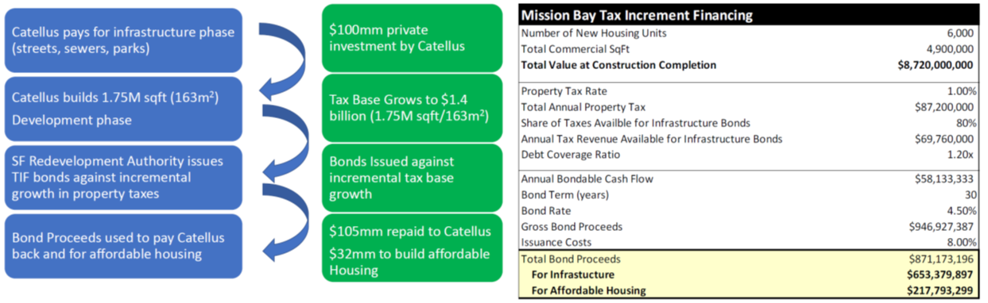
Financing - Example of Tax Increment Financing
Mission Bay’s TIF Flow of Funds
Mission Bay TIF Overall Picture
Source: World Bank, Tokyo Learning Development Center, Technical Deep Dive on Urban Regeneration, February 18-23, 2019

Slide 19
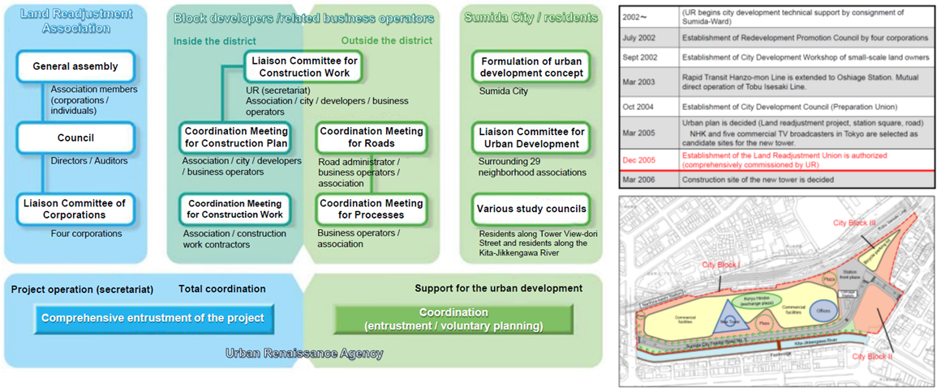
Implementation - Long-term Institutional Set-up
Oshiage, Tokyo, Japan. Redevelopment of a 6.4 hectare site.
Institutional Setup
History and Site
Source: World Bank, Tokyo Learning Development Center, Technical Deep Dive on Urban Regeneration, February 18-23, 2019

Slide 20
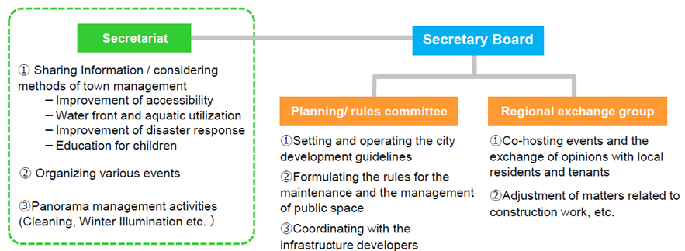
Implementation - Town Management
Toyosu, Tokyo, Japan. After the redevelopment, the institutional set-up of the Town Management council (made up of local residents, tenants and local companies) ensures that the redevelopment area remains attractive.
Institutional Setup of Long-term Town Management
Source: World Bank, Tokyo Learning Development Center, Technical Deep Dive on Urban Regeneration, February 18-23, 2019

Slide 21
Annex

Slide 22
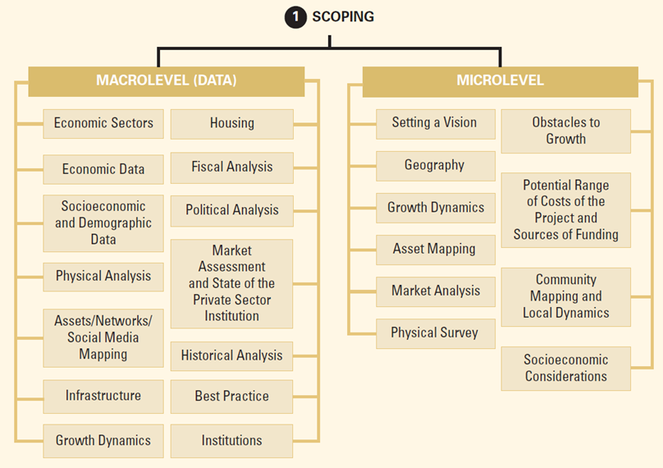
Phase 1 - Scoping
Source: World Bank, Regenerating Urban Land – A Practitioner’s Guide to Leveraging Private Investment

Slide 23
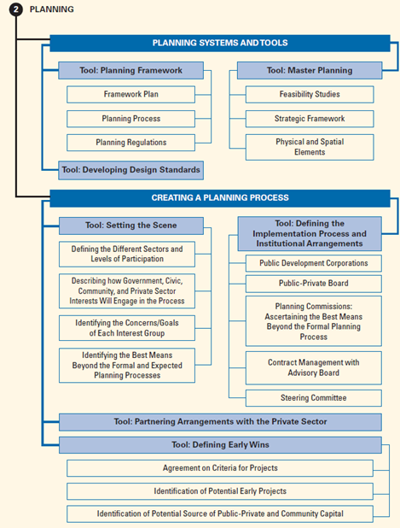
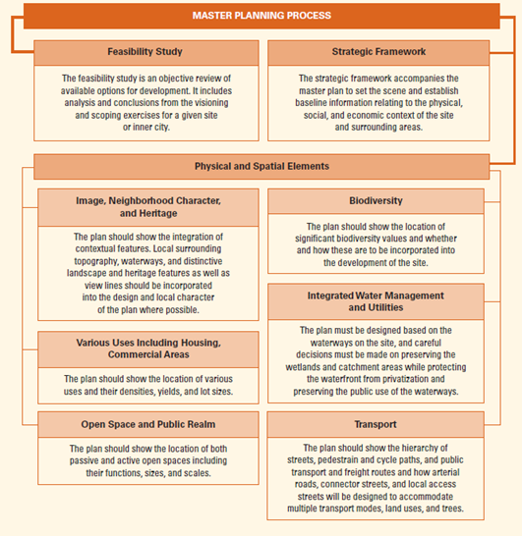
Phase 2 - Planning
Source: World Bank, Regenerating Urban Land – A Practitioner’s Guide to Leveraging Private Investment

Slide 24
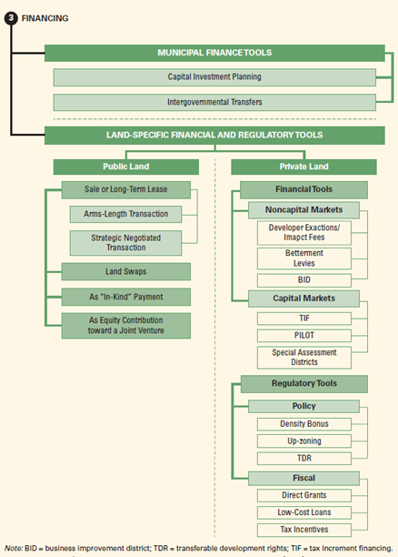
Phase 3 - Financing
Source: World Bank, Regenerating Urban Land – A Practitioner’s Guide to Leveraging Private Investment

Slide 25
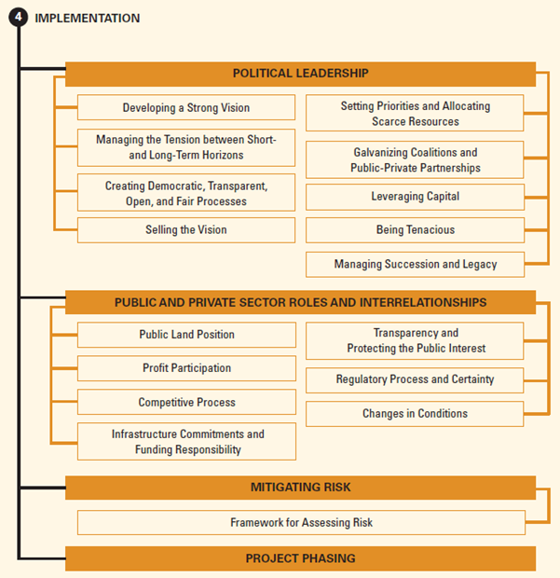
Phase 4 - Implementation
Source: World Bank, Regenerating Urban Land – A Practitioner’s Guide to Leveraging Private Investment

